Slide 1
EVADC Volt Sec Balance Analysis
24 May 2021

Slide 2
ADC signal Details
AFC | DABP | DABS | Control Board
VAC1_SNS_PM1IN | VAC1_SNS_PM2IN | VAC1_SNS_PM3IN | AMB_SENSE_1
VAC2_SNS_PM1IN | VAC2_SNS_PM2IN | VAC2_SNS_PM3IN | AMB_SENSE_2
VAC3_SNS_PM1IN | VAC3_SNS_PM2IN | VAC3_SNS_PM3IN
VDC_SNS_PM1IN | VDC_SNS_PM2IN | ILEG1_SNS_PM3IN
IPH1_SNS_PM1IN | ILEG1_SNS_PM2IN | ILEG2_SNS_PM3IN
IPH2_SNS_PM1IN | ILEG2_SNS_PM2IN | ILEG3_SNS_PM3IN
IPH3_SNS_PM1IN | ILEG3_SNS_PM2IN | IPH1_SNS_PM3IN
ILEG1_SNS_PM1IN | IPH1_SNS_PM2IN | IPH2_SNS_PM3IN
ILEG2_SNS_PM1IN | IPH2_SNS_PM2IN | IPH3_SNS_PM3IN
ILEG3_SNS_PM1IN | IPH3_SNS_PM2IN | TEMP_HS_SNS_PM3IN
TEMP_HS_SNS_PM1IN | TEMP_HS_SNS_PM2IN | TEMP_PCB_SNS_PM3IN
TEMP_PCB_SNS_PM1IN | TEMP_PCB_SNS_PM2IN | TEMP_LEG1_SNS_PM3IN
TEMP_LEG1_SNS_PM1IN | TEMP_LEG1_SNS_PM2IN | TEMP_LEG2_SNS_PM3IN
TEMP_LEG2_SNS_PM1IN | TEMP_LEG2_SNS_PM2IN | TEMP_LEG3_SNS_PM3IN
TEMP_LEG3_SNS_PM1IN | TEMP_LEG3_SNS_PM2IN | 24V_SNS_PM3IN
24V_SNS_PM1IN | 24V_SNS_PM2IN | VDC_SNS_PM3IN
 |  | CUR_SNS
Additional Signals
3V3_SNS_ANG2_PM3IN
3V3_SNS_ANG2_PM1IN
3V3_SNS_ANG1_PM2IN
3V3_SNS_ANG2_PM2IN
3V3_SNS_ANG1_PM3IN
3V3_SNS_ANG1_PM1IN
24V_SNS_SW_PM1IN
24V_SNS_SW_PM2IN
24V_SNS_SW_PM3IN
5V_SNS_PM1IN
5V_SNS_PM3IN
5V_SNS_PM2IN
51 – Required Channel
12 – additional Channel

Slide 3
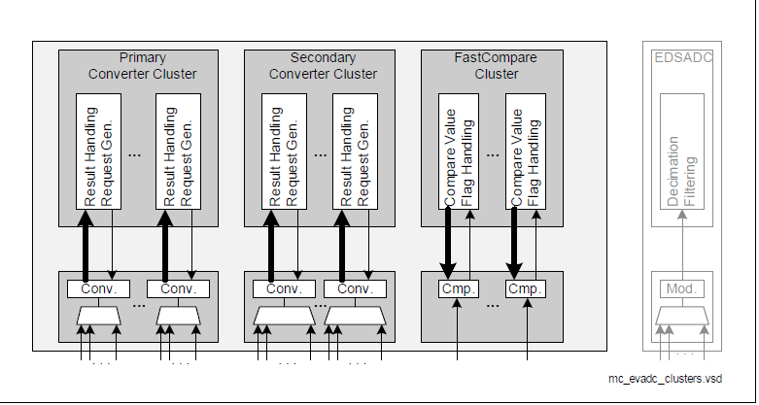
Aurix ADC Architecture
Primary converter cluster - 8 Stage queue - conversion time below 0.5us
Secondary Converter cluster– 16 stage queue – conversion time below 1us
Each group has individual converter, it will work concurrently
8 groups in Tc377 ( 8 converters in total)
Each group has 3 queue with respective stages
Using that queue we can configure the priority of the channel
ADC has 4 priority (highest, high, low, lowest)

Slide 4
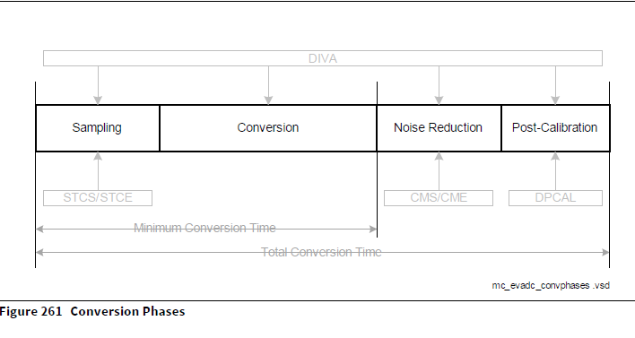
Total Conversion Time – as per Datasheet
ADC Maximum frequency 20Mhz
Sample time minimum 100ns
Result generation time 650ns
Minimum time of conversion without post calibration is 768.75ns (single channel)

Slide 5
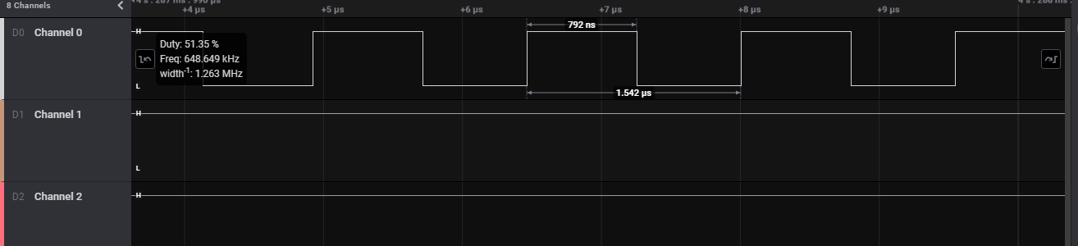
Primary Channel – Practical Reading
Sample time 100ns – primary channel
Each conversion to result generation takes 792ns/750ns for single channel

Slide 6
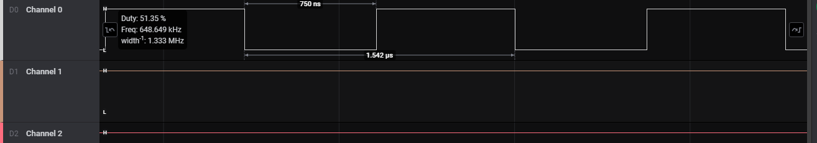
Secondary Channel – Practical Reading
Sample time 100ns – secondary cluster Channel
Each conversion to result generation takes 792ns/750ns for single channel

Slide 7
Closed Loop Channel Configuration
Group 0 and Group 1 converter dedicated to closed loop
Sample Timing of 500ns (1.3us result Generation)
Every 3.9us all 6 channel of Queue 0 will get converted
Closed Loop Channel
Group 0 | Group 1
VAC1_SNS_PM1IN | IPH1_SNS_PM1IN
VAC2_SNS_PM1IN | IPH2_SNS_PM1IN
VAC3_SNS_PM1IN | IPH3_SNS_PM1IN
 | VDC_SNS_PM3IN
Queue – 0 High Priority - result Generation (3.9us)
Queue – 1 Medium Priority conversion starts every 15.6us 4 cycle once

Slide 8
Fault Detection Channels
Remaining Channel in current pin mapping
Configure the channel priority to reduce the conversion timing
Group 8 | Group 9 | Group 11 | Group 3
TEMP_PCB_SNS_PM1IN | IPH1_SNS_PM2IN | ILEG1_SNS_PM1IN | AMB_SENSE_1
TEMP_LEG1_SNS_PM1IN | IPH2_SNS_PM2IN | ILEG2_SNS_PM1IN | 1
TEMP_LEG2_SNS_PM1IN | IPH3_SNS_PM2IN | ILEG3_SNS_PM1IN
TEMP_LEG3_SNS_PM1IN | TEMP_HS_SNS_PM2IN | TEMP_HS_SNS_PM1IN
24V_SNS_PM1IN | TEMP_PCB_SNS_PM2IN | ILEG1_SNS_PM3IN
VAC1_SNS_PM2IN | TEMP_LEG1_SNS_PM2IN | ILEG2_SNS_PM3IN
VAC2_SNS_PM2IN | TEMP_LEG2_SNS_PM2IN | ILEG3_SNS_PM3IN
VAC3_SNS_PM2IN | TEMP_LEG3_SNS_PM2IN | IPH1_SNS_PM3IN
VDC_SNS_PM2IN | 24V_SNS_PM2IN | IPH2_SNS_PM3IN
ILEG1_SNS_PM2IN | VAC1_SNS_PM3IN | IPH3_SNS_PM3IN
ILEG2_SNS_PM2IN | VAC2_SNS_PM3IN | TEMP_HS_SNS_PM3IN
ILEG3_SNS_PM2IN | VAC3_SNS_PM3IN | TEMP_PCB_SNS_PM3IN
12 | AMB_SENSE_2 | TEMP_LEG1_SNS_PM3IN
 | CUR_SNS | TEMP_LEG2_SNS_PM3IN
 | 14 | TEMP_LEG3_SNS_PM3IN
 |  | 24V_SNS_PM3IN
 |  | 16
Additional Signals
3V3_SNS_ANG2_PM3IN
3V3_SNS_ANG2_PM1IN
3V3_SNS_ANG1_PM2IN
3V3_SNS_ANG2_PM2IN
3V3_SNS_ANG1_PM3IN
3V3_SNS_ANG1_PM1IN
24V_SNS_SW_PM1IN
24V_SNS_SW_PM2IN
24V_SNS_SW_PM3IN
5V_SNS_PM1IN
5V_SNS_PM3IN
5V_SNS_PM2IN
We can configure either G11 or G2,G3

Slide 9
Channel Priority
Low Priority
TEMP_HS_SNS_PM1IN
TEMP_PCB_SNS_PM1IN
TEMP_LEG1_SNS_PM1IN
TEMP_LEG2_SNS_PM1IN
TEMP_LEG3_SNS_PM1IN
TEMP_HS_SNS_PM2IN
TEMP_PCB_SNS_PM2IN
TEMP_LEG1_SNS_PM2IN
TEMP_LEG2_SNS_PM2IN
TEMP_LEG3_SNS_PM2IN
TEMP_HS_SNS_PM3IN
TEMP_PCB_SNS_PM3IN
TEMP_LEG1_SNS_PM3IN
TEMP_LEG2_SNS_PM3IN
TEMP_LEG3_SNS_PM3IN
AMB_SENSE_1
AMB_SENSE_2
Medium Priority
24V_SNS_PM1IN
24V_SNS_PM2IN
24V_SNS_PM3IN
VAC1_SNS_PM3IN
VAC2_SNS_PM3IN
VAC3_SNS_PM3IN
CUR_SNS
High Priority
IPH1_SNS_PM1IN
IPH2_SNS_PM1IN
IPH3_SNS_PM1IN
ILEG1_SNS_PM1IN
ILEG2_SNS_PM1IN
ILEG3_SNS_PM1IN
ILEG1_SNS_PM2IN
ILEG2_SNS_PM2IN
ILEG3_SNS_PM2IN
IPH1_SNS_PM2IN
IPH2_SNS_PM2IN
IPH3_SNS_PM2IN
ILEG1_SNS_PM3IN
ILEG2_SNS_PM3IN
ILEG3_SNS_PM3IN
IPH1_SNS_PM3IN
IPH2_SNS_PM3IN
IPH3_SNS_PM3IN
High priority in continuous scanning mode
Voltage to be scanned every 4 cycle of High priority channel scanning
Temperature rising will happen slowly, hence the Low priority Channel will get converted once in every 1sec
Using Priority we can reduce channel which saves the scanning time

Slide 10
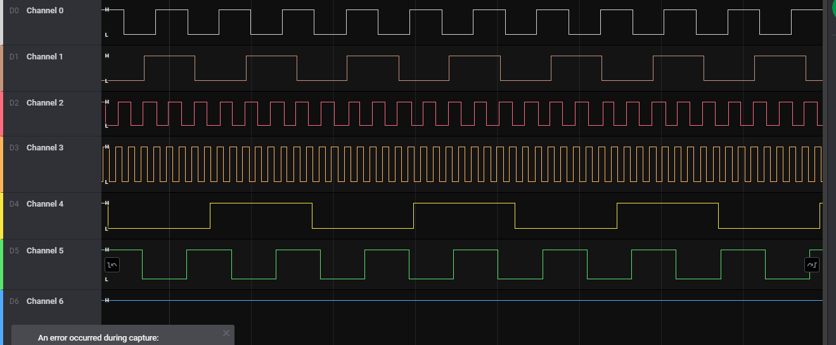
Parallel Conversion Service Request
Sample time - 100ns
Ch 0 – 5 channel configuration – 3.917us
Ch 1 – 8 channel configuration – 6.25us
Ch 2 – 2 channel configuration – 1.583us
Ch3 – 1 channel configuration – 792ns
Ch4 – 16 channel configuration – 12.417us
Ch5 – 8 channel sec configuration – 5.6us
Sample time - 500ns
Ch 0 – 5 channel configuration – 5.917us
Ch 1 – 8 channel configuration – 9.417us
Ch 2 – 2 channel configuration – 2.375us
Ch3 – 1 channel configuration – 1.167us
Ch4 – 16 channel configuration – 18.833us
Ch5 – 8 channel sec configuration – 9.417us

Slide 11
Group 9 Current Configuration
Group 9
IPH1_SNS_PM2IN
IPH2_SNS_PM2IN
IPH3_SNS_PM2IN
24V_SNS_PM2IN
CUR_SNS
VAC1_SNS_PM3IN
VAC2_SNS_PM3IN
VAC3_SNS_PM3IN
TEMP_HS_SNS_PM2IN
TEMP_PCB_SNS_PM2IN
TEMP_LEG1_SNS_PM2IN
TEMP_LEG2_SNS_PM2IN
TEMP_LEG3_SNS_PM2IN
AMB_SENSE_2
High Priority Channel continuous scanning mode (2.3us or 3.9 us once)
Medium Priority Channel 10 cycle of High Priority once (23us or 39 us once)
Low Priority Channel 1-sec once

Slide 12
Group 11 Current Configuration
Group 11
ILEG1_SNS_PM1IN
ILEG2_SNS_PM1IN
ILEG3_SNS_PM1IN
ILEG1_SNS_PM3IN
ILEG2_SNS_PM3IN
ILEG3_SNS_PM3IN
IPH1_SNS_PM3IN
IPH2_SNS_PM3IN
IPH3_SNS_PM3IN
IPH3_SNS_PM3IN
24V_SNS_PM3IN
TEMP_LEG1_SNS_PM3IN
TEMP_LEG2_SNS_PM3IN
TEMP_LEG3_SNS_PM3IN
TEMP_PCB_SNS_PM3IN
TEMP_HS_SNS_PM1IN
High Priority - Every 7.1us or 11.7us
Medium Priority - 10 cycle once (71us or 110us)
Low Priority - 1 sec once

Slide 13
Volt Sec balance in Current Pin Mapping
Requirement
140Khz DAB switching frequency (7.14us)
In 7.14us, we need to scan (10/6) sample of 3 voltage channel to check volt – sec balance
Group 8
VAC1_SNS_PM2IN
VAC2_SNS_PM2IN
VAC3_SNS_PM2IN
VDC_SNS_PM2IN
ILEG1_SNS_PM2IN
ILEG2_SNS_PM2IN
ILEG3_SNS_PM2IN
24V_SNS_PM1IN
TEMP_PCB_SNS_PM1IN
TEMP_LEG1_SNS_PM1IN
TEMP_LEG2_SNS_PM1IN
TEMP_LEG3_SNS_PM1IN
Volt-sec balance Channel
Conversion starts once in 10 cycle of ac voltage
Continuous scanning of Volt sec Bal Channels
Conversion Timing will be 2.3us for 100ns sampling rate and 3.9us for 500ns sampling rate
We will get 3 samples in 100ns sample rate and 1 sample for 500ns sample rate
Risk
  Leg current sensing will get affected.
  During Leg current scanning, converter will stop scanning the voltage channel till the leg current get converted
Converter scan starts 1s once

Slide 14
Group Configuration in Current Pin Mapping
Group 0 | Group 1 | Group 2 | Group 3 | Group 8 | Group 9 | Group 10 | Group 11
4 | 4 | 5 | 6 | 12 | 14 | 3 | 16
Group 8 | Group 9 | Group 11 | Group 3
TEMP_PCB_SNS_PM1IN | IPH1_SNS_PM2IN | ILEG1_SNS_PM1IN | AMB_SENSE_1
TEMP_LEG1_SNS_PM1IN | IPH2_SNS_PM2IN | ILEG2_SNS_PM1IN | 1
TEMP_LEG2_SNS_PM1IN | IPH3_SNS_PM2IN | ILEG3_SNS_PM1IN
TEMP_LEG3_SNS_PM1IN | TEMP_HS_SNS_PM2IN | TEMP_HS_SNS_PM1IN
24V_SNS_PM1IN | TEMP_PCB_SNS_PM2IN | ILEG1_SNS_PM3IN
VAC1_SNS_PM2IN | TEMP_LEG1_SNS_PM2IN | ILEG2_SNS_PM3IN
VAC2_SNS_PM2IN | TEMP_LEG2_SNS_PM2IN | ILEG3_SNS_PM3IN
VAC3_SNS_PM2IN | TEMP_LEG3_SNS_PM2IN | IPH1_SNS_PM3IN
VDC_SNS_PM2IN | 24V_SNS_PM2IN | IPH2_SNS_PM3IN
ILEG1_SNS_PM2IN | VAC1_SNS_PM3IN | IPH3_SNS_PM3IN
ILEG2_SNS_PM2IN | VAC2_SNS_PM3IN | TEMP_HS_SNS_PM3IN
ILEG3_SNS_PM2IN | VAC3_SNS_PM3IN | TEMP_PCB_SNS_PM3IN
12 | AMB_SENSE_2 | TEMP_LEG1_SNS_PM3IN
 | CUR_SNS | TEMP_LEG2_SNS_PM3IN
 | 14 | TEMP_LEG3_SNS_PM3IN
 |  | 24V_SNS_PM3IN
 |  | 16
We can configure either G11 or G2,G3

Slide 15
Group Configuration in Current Pin Mapping (Cont)
Group 0 | Group 1 | Group 2 | Group 3 | Group 8 | Group 9 | Group 10 | Group 11
4 | 4 | 5 | 6 | 12 | 14 | 3 | 16
Group 2 | Group 3 | Group 10
3V3_SNS_ANG2_PM3IN | 3V3_SNS_ANG1_PM1IN | SNS_SPARE2IN
SNS_SPARE4IN | SNS_SPARE3IN | SNS_SPARE1IN
3V3_SNS_ANG2_PM1IN | 24V_SNS_SW_PM1IN | 5V_SNS_PM1IN
3V3_SNS_ANG1_PM2IN | 24V_SNS_SW_PM2IN | SNS_SPARE5IN
3V3_SNS_ANG2_PM2IN | 24V_SNS_SW_PM3IN | SNS_SPARE7IN
3V3_SNS_ANG1_PM3IN | 5 | SNS_SPARE8IN
6 |  | SNS_SPARE6IN
 |  | 5V_SNS_PM3IN
 |  | 5V_SNS_PM2IN
 |  | 9
Impact
  Extra efforts on Control Board SW

Slide 16
Alternate Option
Remapping the Volt sec bal channel to G2,G3,G10 (single channel each)
For sampling time of 100ns all 3 channel will get converted in 792ns and for 500ns result will get in 1.3us
Map the 3 leg current each in separate groups or use Fast Compare Converter for 4 leg current
Impact
  Extra efforts on Control Board HW and SW

Slide 17
Fast Compare Channel
4 Fast compare channel in Tc377
Comparing time will be 218 ns
We can use this features to scan the leg current to protect the mosfet
Reading result is not possible in Fast Compare Mode
9 leg current sensing pin in All 3 board
EVADC_FC2CH0 | Group9Ch0 | P00.12 | IPH1_SNS_PM2IN
EVADC_FC3CH0 | Group9Ch1 | P00.11 | IPH2_SNS_PM2IN
EVADC_FC0CH0 | Group2Ch0 | AN16 | 3V3_SNS_ANG2_PM3IN
EVADC_FC1CH0 | Group2Ch1 | AN17 | SNS_SPARE4IN

Slide 18
Risks
Volt Sec Balance Service routine will trigger in every 750ns
Volt Sec Balance Conversion Service has to be end within 750ns (check once the approach finalised)
We utilized 2-core ( closed loop , Remaining Functionality), hence the volt sec balance functionality will utilize 3-rd core, complicate to handle sharing values between the core as data will update at every cycle)
As multiple ADC interrupts will hit, control loop timing might get affected

Slide 19
Summary
With current pin mapping, only 3 samples of DAB primary voltage is possible every cycle at 100ns sampling time
Alternate option is to remap, but involves extra efforts and risks

Slide 20
THANK YOU
C_PMC_11F/5.1/27-Feb-19

